Slide 1
Intervention Analysis: Heat Exposure Illnesses among Farmworkers in Southern U.S.
Casen 4: Simrika Joshi, Camden Wood, Surafele Sintayehu, April Chou, Audrija Bhattacharya

Slide 2
Background
Heat-related illness (HRI) among farmworkers in the southern United States is a major public health concern.
90% of farmworkers experience extreme heat exposure and report symptoms of heat illness¹
Symptoms include heat stroke and death; and farmworkers have a higher mortality rate than other US workers²
Factors like low wages, piece-rate pay, limited access to water, shade, and breaks, and inadequate housing conditions exacerbate the issue^{3,4}
Climate change promises to worsen conditions, with rising temperatures expected to increase both exposure and health risks.⁵

Slide 3
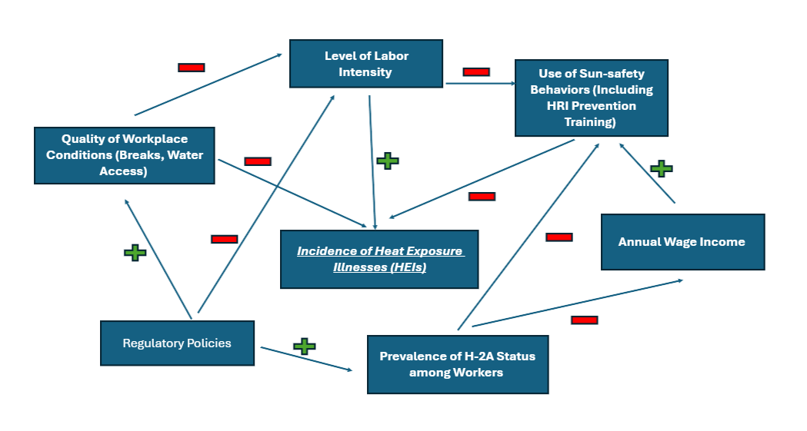
Systems Map
Quality of Workplace Conditions:
Medium changeability
High importance
Upstream of level of labor intensity and incidence of heat exposure illnesses (HEIs)
Downstream of regulatory policies
SEF: Community Level
Quality of Workplace Conditions directly and indirectly influences Incidence of heat exposure illnesses and is the best area to implement an intervention.

Slide 4
Intervention: Hydration Backpack Systems⁶
SEF: Social Network
Reach | Farmworkers in eastern North Carolina receive hydration backpacks in early growing seasons Of those who received backpacks, 47 male Latino and migrant farmworkers (with H-2A guest worker visa) participated in surveys via convenience sample 27% had graduated high school; 68% had some education
Effectiveness | Average of 4.8 ± 2.2 liters of water intake was reported, with 87% drinking water every 15 minutes Increased water consumption by 92% among farmworkers surveyed⁷ 79% participants reported more water intake with backpack; 87% reported no interference with work
Adoption | Partnership with Federally Qualified Health Center (FQHC) to purchase the backpacks Challenges on the compliance of employers to purchase hydration backpacks for employees.
Implementation | 92% reported the backpack was simple to implement in their work Backpacks from Stealth Angel Survival © that were 17’” tall and 7” wide ($20 for system cost)
Maintenance | 89% participants expressed interest in continued usage of the backpack Training session on instructions to disinfect and sanitize backpacks for longetivity
Notes:
Simrika
Hydration Backpack system:
Works within the social network level of the SEF
Conducted researched in eastern North Craolina
Initially disbributed 200 backpacks
Around 50 participants completed the survey about the effectiveness of this intervention
All male, hispanic, migrant farmworkers
Only 27% had a high school diploma, with majority having some middle school education
Being paid through piece-rate system (paid by the hour)
Intervention was very effective with a 92% increase in water intake and a majority reporting their satisfaction with the backpacks
Partnership with the employers or the government program may be needed to adopt this one a larger scale
Majority reported that this backpack could be implemented in their work without interference
Majority expressed continued interested, but a training session may be required.
Reason why this intervention is not community-level when the leverage point is: the study suggested no restriction by the town’s stakeholders, so this intervention happens between the employer and employee level.
Biases in convenience sample: limitation to this pilot program, more pilot studies can help with this. Also expanding this to collect data from diverse population of farmworkers.
The 4.8 liters was a her shift intake.
Incentives could be provided to have better adoption to this system.

Slide 5
Intervention: Work Place HRI Training⁸⁻¹⁰
SEF: Community
Reach | 329 municipal outdoor workers from a mid-sized Central Texas city whose job descriptions involved outdoor work in extreme temperatures with medium to very heavy physical demands
Effectiveness | The Heat-related Illness (HRI) rate averaged 19.5 per 1,000 workers during 2011-2015 HRI rate dropped to 1.01 per 1,000 workers from 2015–2017 When the medical surveillance component was removed in the modified program (2018–2019), HRI rate increased to 7.6 per 1,000 workers
Adoption | Participants were workers that came from Parks and Recreation, Streets and Traffic, Solid Waste, and Utilities departments in the Central Texas city
Implementation | Department supervisors and employees trained, reducing workload on high temperature days, and medical surveillance on site was implemented each year of the study before the hot season of May through September
Maintenance | Outcomes tracked from 2011- 2019 but llimited by the COVID-19 and closure of the employee health clinic in 2020 The 7-year observation period for the full program and 2-year period for the modified program

Slide 6


Comparative Assessment: Advantages⁶⁻¹⁰
Advantages
Hydration Backpack Systems | Workplace HRI Training
Effectiveness: Increased water consumption among farmworkers in Eastern North Carolina Implementation: Relatively cost-effective product Maintenance: Majority reported interest in continued usage and minimal interference with work | Reach: Theoretically, implementation would affect more individuals overall Implementation: Easy, quick, and non-resource intensive method (especially for companies)
Notes:
Simrika
Hydration Backpack system:
Increased water consumption significantly, which is within the effectiveness of the REAIMS
Suggesting it could also increase to other farmlands
Only $20 per backpack, so relatively cost-effective for its implementation and adoption
Could be a long-term solution for farmworkers if they have proper training to sanitize the backpack and work in larger field that have water sanitions further
Workplace HRI Training
Training about prevention stategies can be performed in groups and cover more topics, positive impacting reach
Easier to implement because it only requires a small team to hold a large training session

Slide 7
Comparative Assessment: Limitations⁶⁻¹⁰
Disadvantages
Hydration Backpack Systems | Workplace HRI Training
Adoption: Small sample size for pilot study Implementation: Dependent on employer’s willingness to provide backpacks Effectiveness: May exacerbate lower back concerns | Implementation: Form/style of implementation is critical (i.e., online training modules less effective than in-person sessions) Effectiveness: Immigant/H-2A workers systemically score less on post-training comprehension assessments Implementation: Dependent on employer’s willingness to use company time for training sessions
Rationale for selection:¹¹
Significant increase in water consumption → decreased risk of dehydration
The distribution of hydration backpacks among farmworkers leads to fewer heat-related illnesses. This intervention is within social network-level intervention.

Slide 8
Adaptation of Hydration Backpack Systems
Changes Needed:
Adapt to include non-H-2A workers, women, and other non-NC Southern states⁶
Modification for different terrain and work responsibilities (driving, harvesting, etc)
Intervention is already versatile – fundamental natural is not changing
Generating Buy-In:
Partner with Federally Qualified Health Centers (FQHCs) to distribute backpacks⁶
Engage employers by emphasizing that hydration improves labor productivity, per FAO findings¹²
Culturally appropriate education materials for Spanish-speaking workers
Measuring Outcomes:
Track daily water intake (volume consumed per shift)
Administer pre/post surveys on HRI symptoms and record incidence to FQHCs or clinics
Monitor dehydration rates at end of shift
Sustaining Long-Term Implementation:
Seek funding through agricultural health grants, FQHC partnerships, and state health departments
Provide training sessions on backpack sanitation and maintenance (89% interested in continuous use)⁶
Establish employer compliance tied to OSHA guidance

Slide 9

Logic Model: Backpack Hydration Systems
Inputs
Activities
Outputs
Short Term Outcomes
Long Term Outcomes
Funding from FQHCs, grants, and state/federal health agencies Backpacks from Stealth Angel Survival © (~$20 each)⁶ Community health workers/outreach staff Educational materials on health illness prevention | Distribute hydration backpacks to farmworkers Conduct training sessions on backpack use, hydration frequency, and sanitation for employers and workers Administer baseline and follow-up surveys to monitor heat-illness symptoms | Number of backpacks distributed across worksites Number of workers trained on backpack use Number of employer sites engaged and compliant Survey data collected on water intake and symptom reporting | Increased daily water consumption (92% increase in original study)⁶ Higher frequency of water intake during shifts Reduced heat illness symptoms such as excessive thirst, sweating, and fatigue Improved worker awareness of sun-safety and HRI prevention behaviors | Reduction in incidence of heat-related illnesses among rural Southern farmworkers Decreased fatalities due to dehydration across agricultural season Stronger employer and FQHC infrastructure for ongoing heat illness prevention

Slide 10
Heat Related Illnesses are a preventable outcome of the lack of infrastructure to support a healthy working environment among Southern Farmers and Hydration Backpack Systems directly reduce this risk

Slide 11
References:
1. Mirabelli MC, Quandt SA, Crain R, et al. Symptoms of heat illness among Latino farm workers in North Carolina. Am J Prev Med. 2010;39(5):468-471. doi:10.1016/j.amepre.2010.07.008
2. Gubernot DM, Anderson GB, Hunting KL. Characterizing occupational heat-related mortality in the United States, 2000-2010: an analysis using the Census of Fatal Occupational Injuries database. Am J Ind Med. 2015;58(2):203-211. doi:10.1002/ajim.22381
3. Arcury TA, Summers P, Talton JW, et al. Heat Illness among North Carolina Latino Farmworkers. J Occup Environ Med Am Coll Occup Environ Med. 2015;57(12):1299-1304. doi:10.1097/JOM.0000000000000552
4. Arcury TA, Summers P, Talton JW, Nguyen HT, Chen H, Quandt SA. Job characteristics and work safety climate among North Carolina farmworkers with H-2A visas. J Agromedicine. 2015;20(1):64-76. doi:10.1080/1059924X.2014.976732
5. Iglesias-Rios L, O’Neill MS, Handal AJ. Climate Change, Heat, and Farmworker Health. Workplace Health Saf. 2023;71(1):43-43. doi:10.1177/21650799221135581
6. Mizelle E, Modly LA, Smith DJ. Farmworker Acceptability of Backpack Hydration Systems. J Agromedicine. 2024;29(3):477-485. doi:10.1080/1059924X.2024.2349022
7. Mizelle E, Larson KL, Bolin LP, Kearney GD. Fluid Intake and Hydration Status Among North Carolina Farmworkers: A Mixed Methods Study. Workplace Health Saf. 2022;70(12):532-541. doi:10.1177/21650799221117273
8. Perkison WB, Schaefer CM, Green-McKenzie J, Roy RW, Shofer FS, McCarthy RB. Outcomes for a Heat Illness Prevention Program in Outdoor Workers: A 9-Year Overview. J Occup Environ Med. 2024;66(4):293. doi:10.1097/JOM.0000000000003051
9. El Khayat M, Halwani DA, Hneiny L, Alameddine I, Haidar MA, Habib RR. Impacts of Climate Change and Heat Stress on Farmworkers’ Health: A Scoping Review. Front Public Health. 2022;10. doi:10.3389/fpubh.2022.782811
10. Chicas R, Xiuhtecutli N, Dickman NE, et al. Cooling Interventions Among Agricultural Workers: Qualitative Field-Based Study. Hisp Health Care Int. 2021;19(3):174-181. doi:10.1177/1540415321993429
11. Centers for Disease Control (CDC). About Water and Healthier Drinks. Healthy Weight and Growth. March 5, 2026. Accessed April 19, 2026. https://www.cdc.gov/healthy-weight-growth/water-healthy-drinks/index.html
12. Diannes Staal Wasterlund. Managing Heat in Agricultural Work. Increasing Worker Safety and Productivity by Controlling Heat Exposure. 1st ed. FAO; 2018. Accessed March 30, 2026. https://openknowledge.fao.org/handle/20.500.14283/i9179en

Slide 12
AI Attestation
We attest that this submission did not use AI in its development or in the creation of any of its components.

Slide 13
Thanks!

